Slide 1

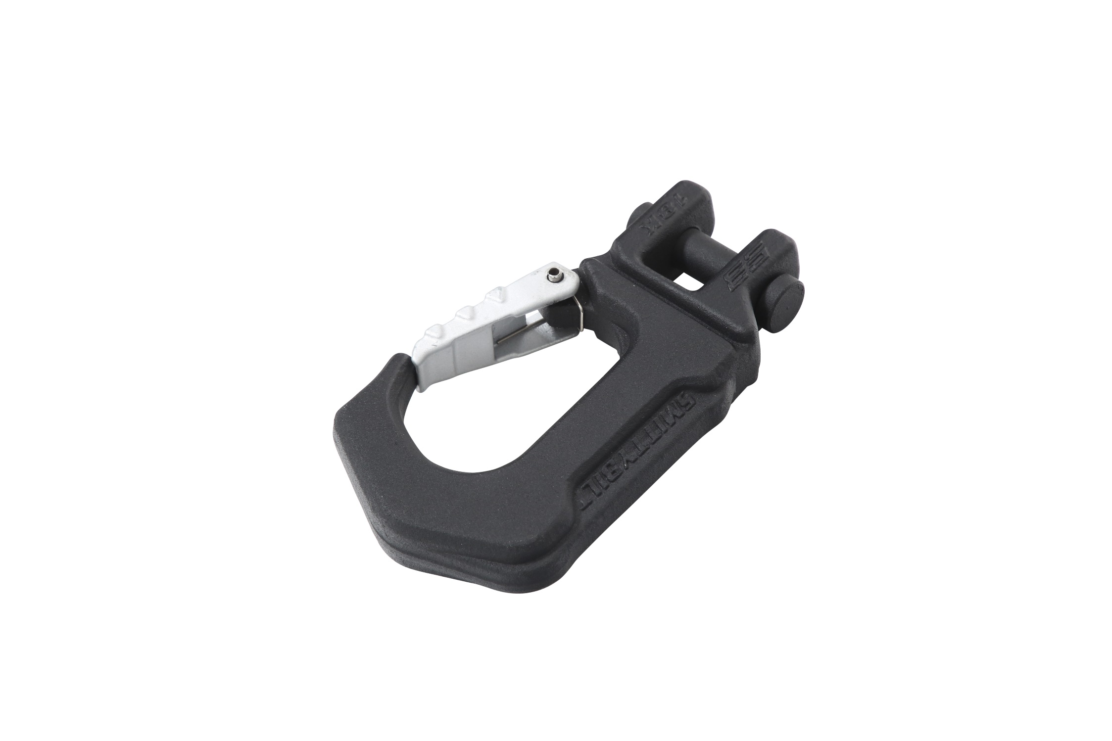
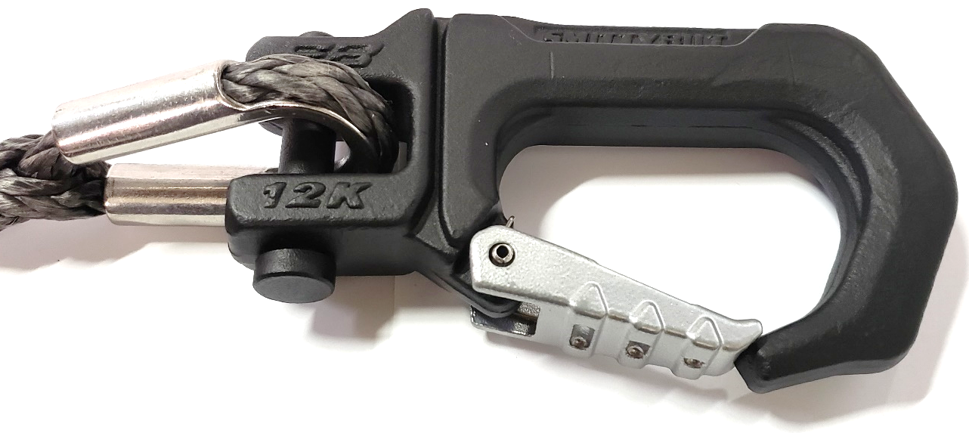
Installation Instructions
Delta Winch Hook
Part# 99012 & 99018
WWW.SMITTYBILT.COM
NOTE: Carefully read entire instructions thoroughly before attempting to install this part.
Photos are for illustration purposes and actual product may vary. Install remains the same
Available for 12k and 18k winch capacities
Heavy duty spring loaded latch for secure hook up rigging
Heat treated double sheer pin locks in place with E-clip for easy attachment
Radiused body for flush mounting against most roller or hawse fairleads.
Durable powder coated finish
For Technical Support/Warranty Information please call 310-762-9944
Smittybilt, 400 W. Artesia Blvd Compton, CA 90220

Slide 2

Installation Instructions
Delta Winch Hook
Part# 99012 & 99018
WWW.SMITTYBILT.COM
Never side load winch hook.
Inspect hook before and after each use. Do not use hook if damage is present.
Never hook winch hook onto winch rope.
DO NOT exceed winch hook’s working load limit capacity.
Only attach to rated recovery points.
Never attach to suspension components for recovery.
Always setup rigging so that the winch hook opening is facing up and towards the sky. In case of winch tackle failure, there is more of a chance the flying tackle is directed towards the ground instead of projecting upwards into harms way.
When retracting winch rope always use a hook strap.
NEVER put fingers inside the hook area as you are powering in the winch.
It is advised that the winch hook is snugged up flat against the fairlead for storage.
Avoid shock loads which may over load winch, winch hook, winch rope, or winch mounting points.
Discontinue use if throat opening has been overloaded / compromised when latch does not catch on the tip of the hook.

Slide 3
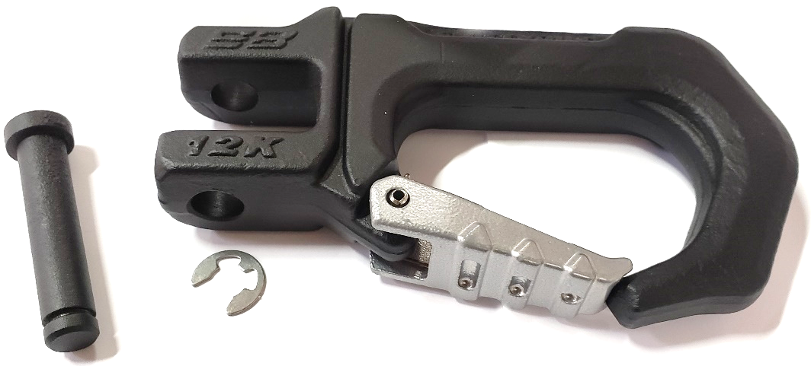
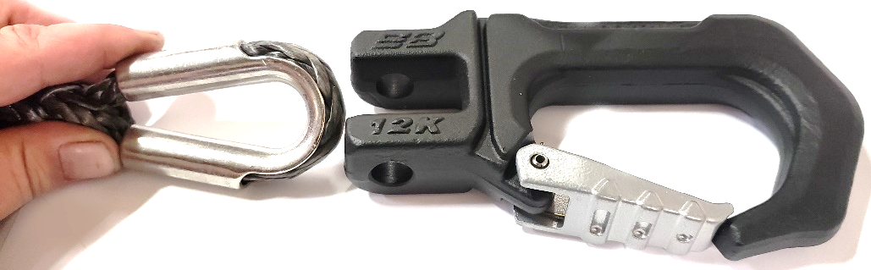
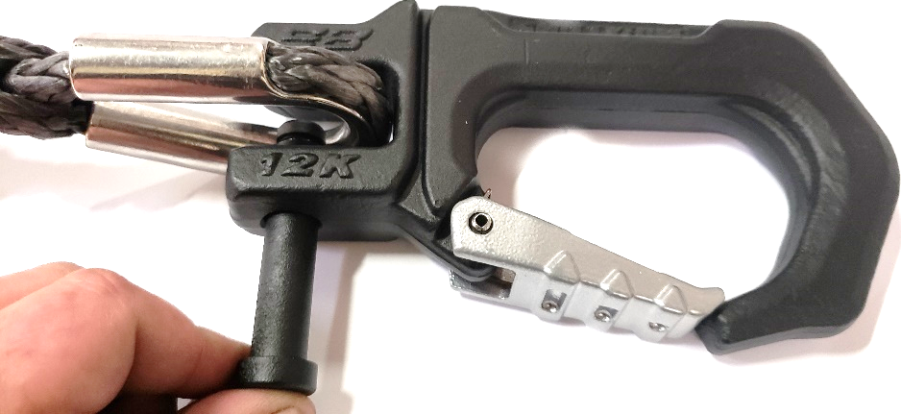
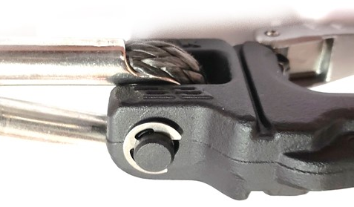
Installation Instructions
Delta Winch Hook
Part# 99012 & 99018
WWW.SMITTYBILT.COM
Step 1: Remove existing winch hook from winch rope. If removal requires cutting of old hook off winch rope, always protect rope and thimble.
Step 2: Remove e-clip from the shear pin, then remove shear pin from winch hook. Fig 1.
Step 3: Insert winch rope/thimble into hook( fig 2) and secure with shear pin(fig 3) and e-clip. Ensure e-clip is fully seated in the groove on the shear pin. Fig 4.
Fig 1
Note: Periodically lube the latch pivot with Breakfree CLP to ensure smooth operation.
Fig 2
Fig 3
Fig 4

Slide 4
Installation Instructions
Delta Winch Hook
Part# 99012 & 99018
WWW.SMITTYBILT.COM
Limited Warranties
Smittybilt’s products are covered under the following limited 1 year warranties only. Note that the duration of the limited warranty differs according to the material and finish of the product purchased. Subject to the 1 year duration and conditions of the limited warranty stated below, Smittybilt warrants to the original retail purchaser that its products are free from defects in material and workmanship. All other warranties and representations express or implied, are hereby disclaimed, including fitness for merchantability and buyer’s intended use or purpose. All parts are sold “AS IS” except for the limited warranties granted herein. Buyer assumes all risks as to the selection, suitability and performance of all goods and products selected. This limited warranty does not cover damage or impairment in any part due to misuse, improper installation, accident or contact with on-road or off-road hazards, product modification, improper or inadequate cleaning and/or maintenance. Smittybilt is not responsible for items damaged during shipping. This warranty is not transferable from the original buyer. For the original Buyer to be eligible for the limited warranty coverage, the Buyer must provide proof of purchase. Smittybilt strongly recommends returning the warranty registration card.
Customer’s remedy hereunder shall be limited only to repair or replacement (at Smittybilt’s option) of any defective part(s) returned to Smittybilt at customer’s expense. The determination of whether or not a returned part is defective or subject to coverage under the limited warranties stated herein shall be made at Smittybilt’s sole discretion.
To assure product quality, Smittybilt reserves the right to change product design, material, specification and finishes without prior notice to customers. This limited warranty gives you specific legal rights and you may also have other rights, which may vary from state to state. Some states do not allow limitations on how long an implied warranty lasts, so the above limitations may not apply as to you. Also, some states do not allow the exclusion or limitation of incidental or consequential damages, so the above limitations or exclusions may not apply to you. Smittybilt reserves the right to discontinue product lines and substitute products, or provide other remedies than those listed in this limited warranty for those discontinued products.
Warning
Rollover and other types of vehicle accidents may result in serious injury or death to you, your passengers and others sharing the road. Smittybilt accessories are decorative and are not intended to reduce or avoid injury or damage in the event of an accident. The weight and location of Smittybilt accessories may affect your vehicles’ handling, stability and performance, creating an increased risk of accident or rollover. Before installing any accessory, check state laws and assure that the accessory will not obscure any lights or interfere with proper operation on your vehicle’s safety equipment. Consult your owner’s manual and the Smittybilt instructions, or additional safety information. Smittybilt products, nor the warnings contained herein, are not a substitute for your safe driving. Don’t drink and drive, always use seat belts and don’t drive faster than conditions permit.

